Slide 1

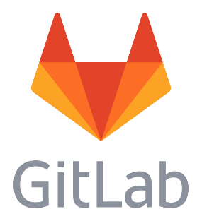
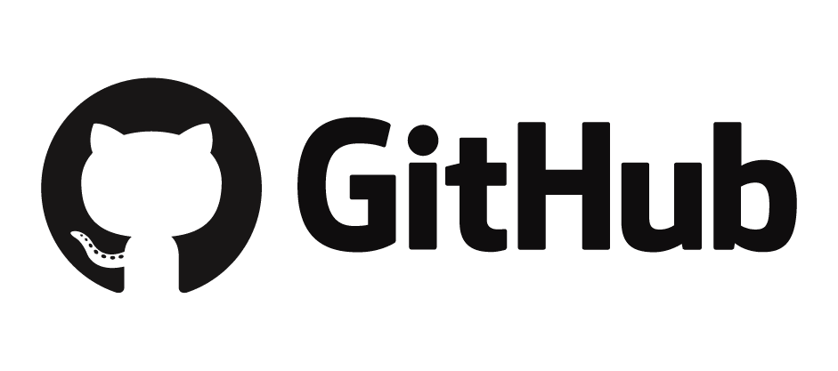
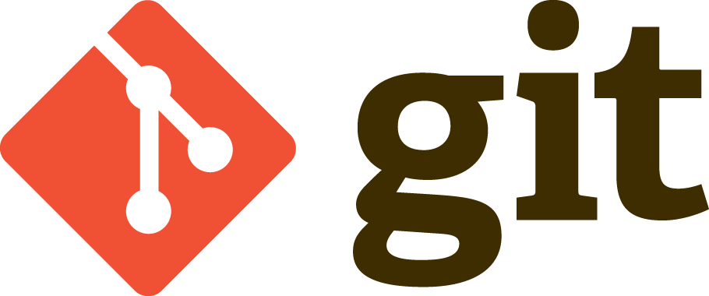
Op naar distributed revision control en source code management bij VODW
Version control and open source

Slide 2
Contents
What is version control and why do we need it?
What is Git?
Why Git, GitHub and GitLab?
Demo: Vermogensmonitor en CE Package
Frequent Git Actions
Final Note: Why open scource is important

Slide 3
Contents
What is version control and why do we need it?
What is Git?
Why Git, GitHub and GitLab?
Demo: Vermogensmonitor en CE Package
Frequent Git Actions
Final Note: Why open scource is important

Slide 4

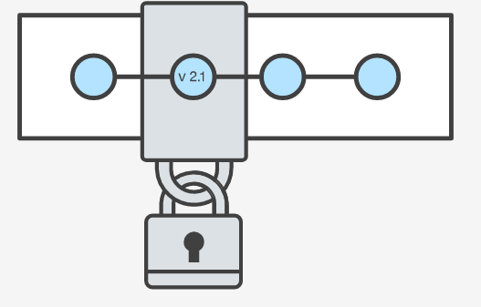
What is version control?
Version control systems are a category of software tools that help a software team manage changes to source code over time.
Version control protects source code from both catastrophe and the casual degradation of human error and unintended consequences.
The primary benefits you should expect from version control are as follows:
A complete long-term change history of every file.
Working on an individual feature without effecting the source (branching and merging).
Traceability.
The question is not whether to use version control but which version control system to use.

Slide 5
What is Git?
Git is a version control system
Git is:
Most widely used,
Mature and modern
Open source
Actively maintained
Integrated in many IDE’s
Distributed
In Git, every developer's working copy of the code is also a repository that can contain the full history of all changes.
Git has been designed with performance, security and flexibility in mind.
Git is the most widley used and modern distributed version control system in the world today.
Notes:
Git is a mature, actively maintained open source project originally developed in 2005 by Linus Torvalds, the famous creator of the Linux operating system kernel.

Slide 6
Contents
What is version control and why do we need it?
What is Git?
Why Git, GitHub and GitLab?
Demo: Vermogensmonitor en CE Package
Frequent Git Actions
Final Note: Why open scource is important

Slide 7

Why Git, Github and GitLab?

Slide 8
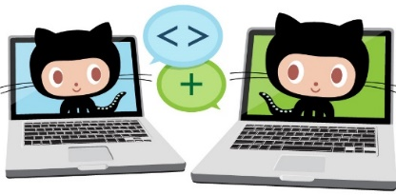
What are GitHub and GitLab?
GitHub (freemium) and GitLab (open source) are web-based repository hosting services.
 | Git | GitHub/GitLab
interface | command line | grafical
repository | local | remote or self hosted
extra’s | - | many integrations like e.g. Trello open source community
GitHub en GitLab are among the most popular web-based repository hosting services.
Notes:
Repositories can contain all sorts of files. Next code from all sort of languages, for example data files and graphical files can be part of your repository.

Slide 9
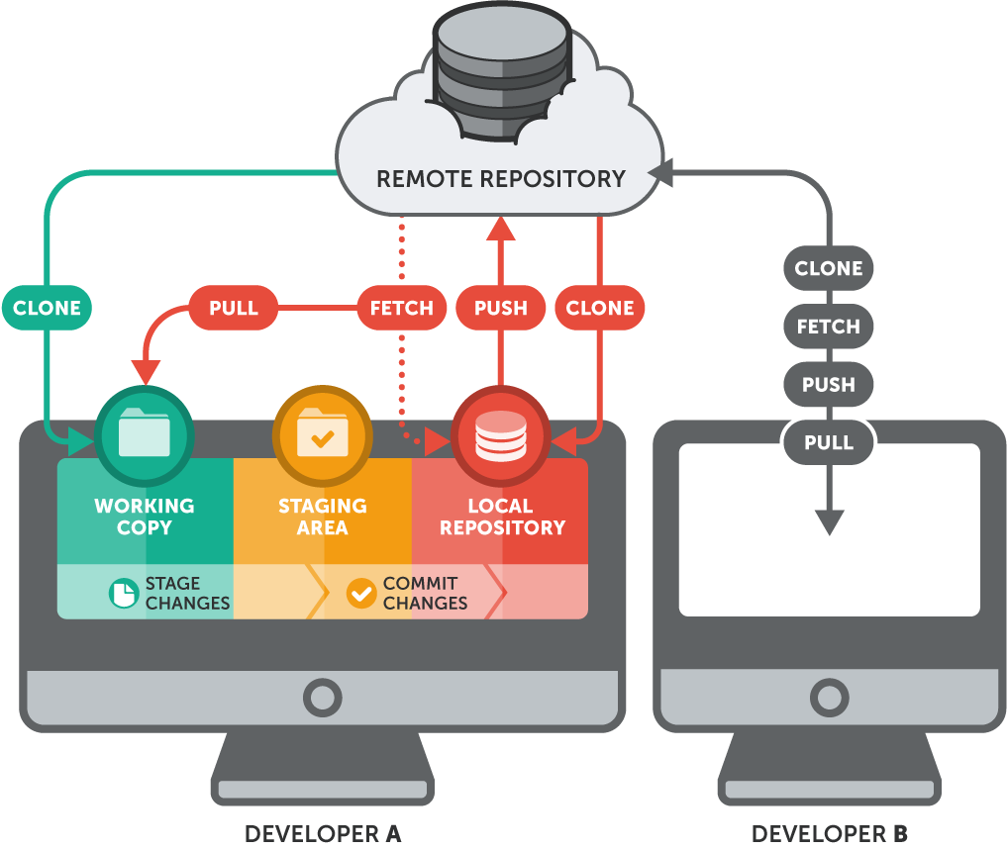

Slide 10
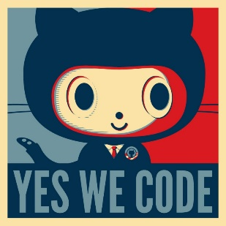
Why should we invest in the Git workflow ?
Git makes necessary version control efficient and effective.
Git has the functionality, performance, security and flexibility
Git is undoubtedly the successor to the previous generations of successful open source version control systems, SVN and CVS
Why GitHub for Open Source?
“Github is like Facebook for programmers. Everyone’s on there. You can look at what they’re working on and easily peruse their code and make suggestions or changes.”
Why GitLab for projects that are not open?
GitLab is unlike GitHub free for private repositories. It works the same as GitHub and in case we choose to use GitHub for all our work it is easy to migrate.
The version control WoW is a must the software tools are a choice
Notes:
Why not only gitlab? (deze vraag ga je denk ik krijgen). Zou ik niet op slide opnemen maar wel in je voice over direct noemen.

Slide 11
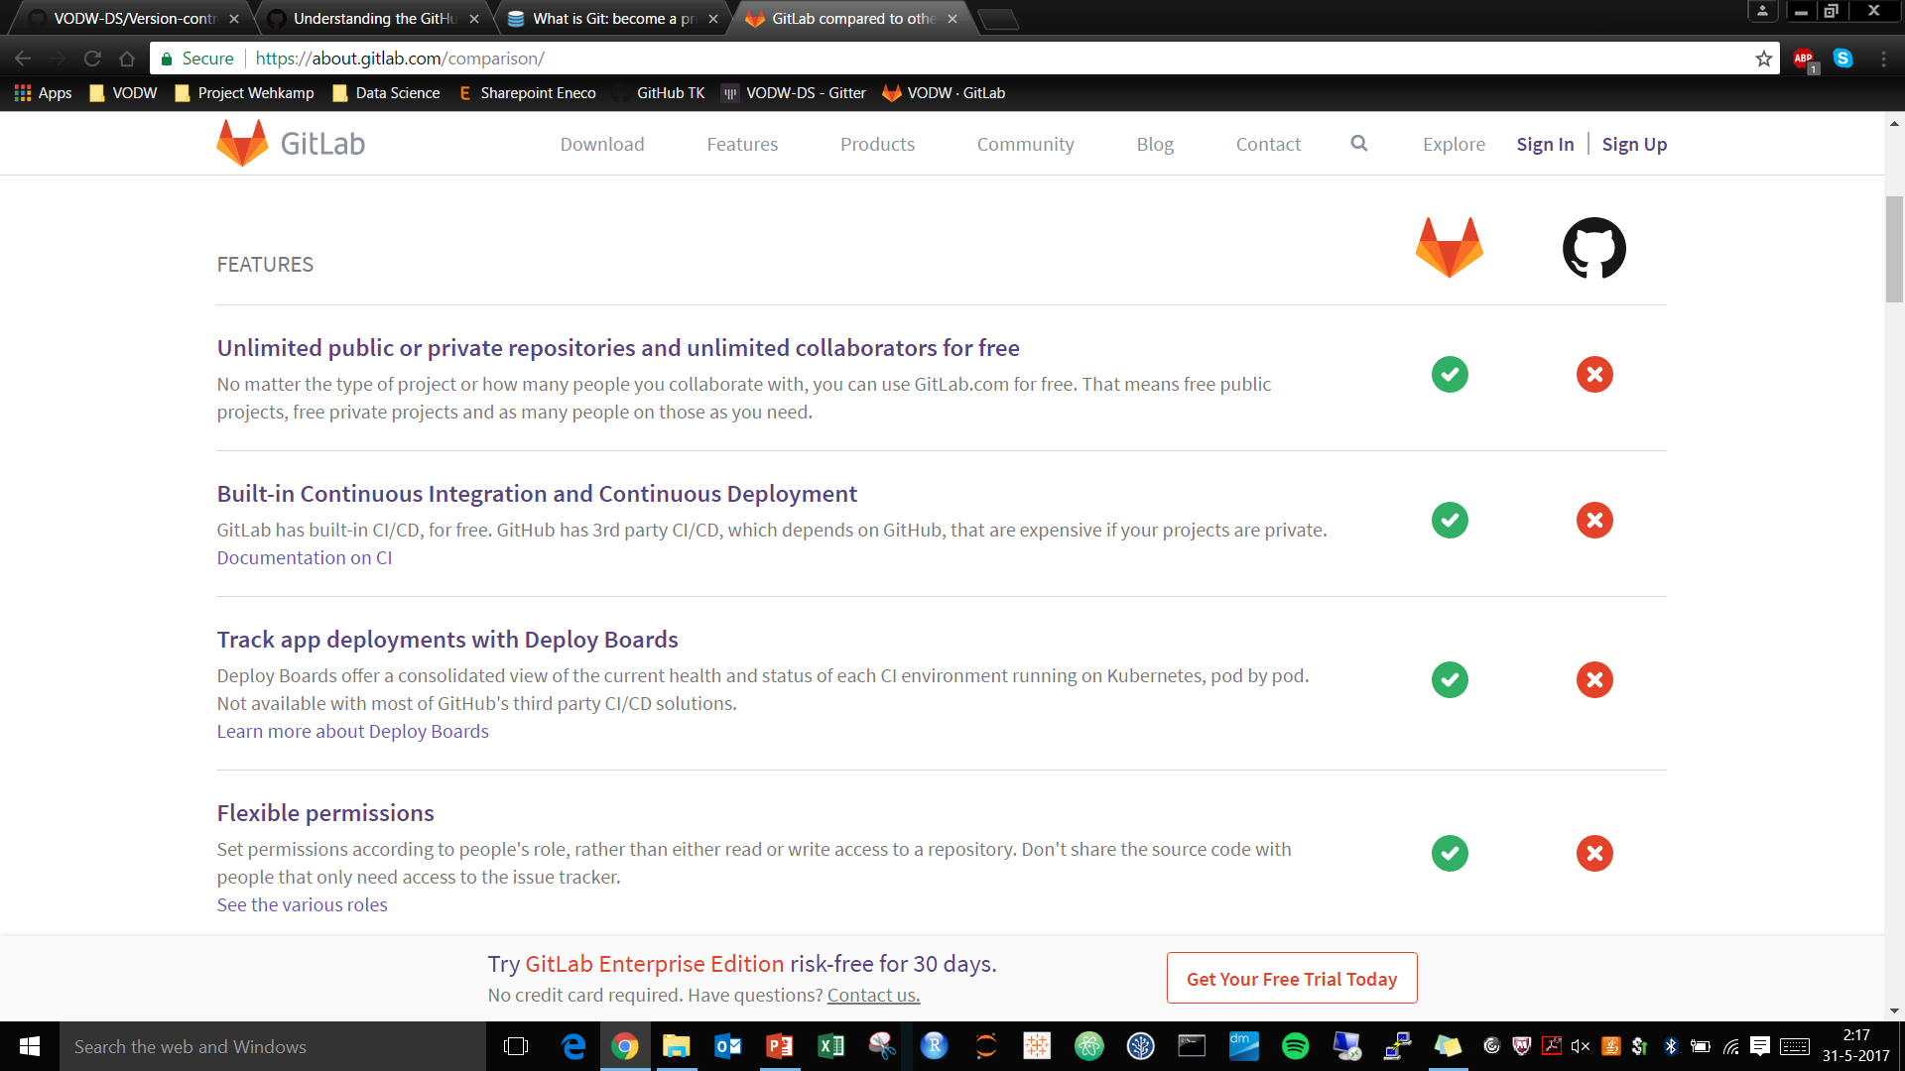
GitLab is free, also for private repositories.

Slide 12
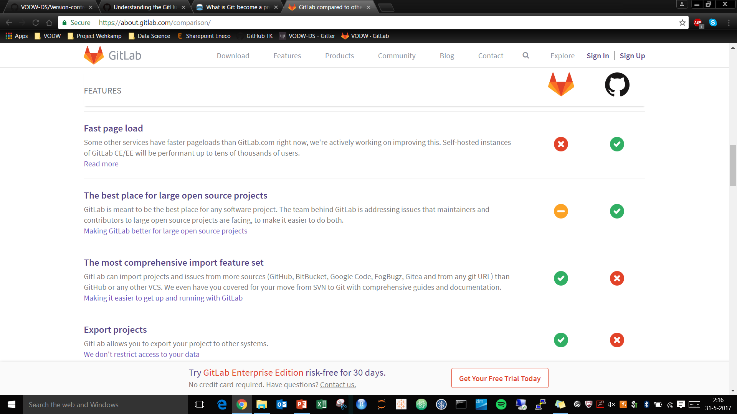
GitHub for Open Source, GitLab gives the honest answer.

Slide 13
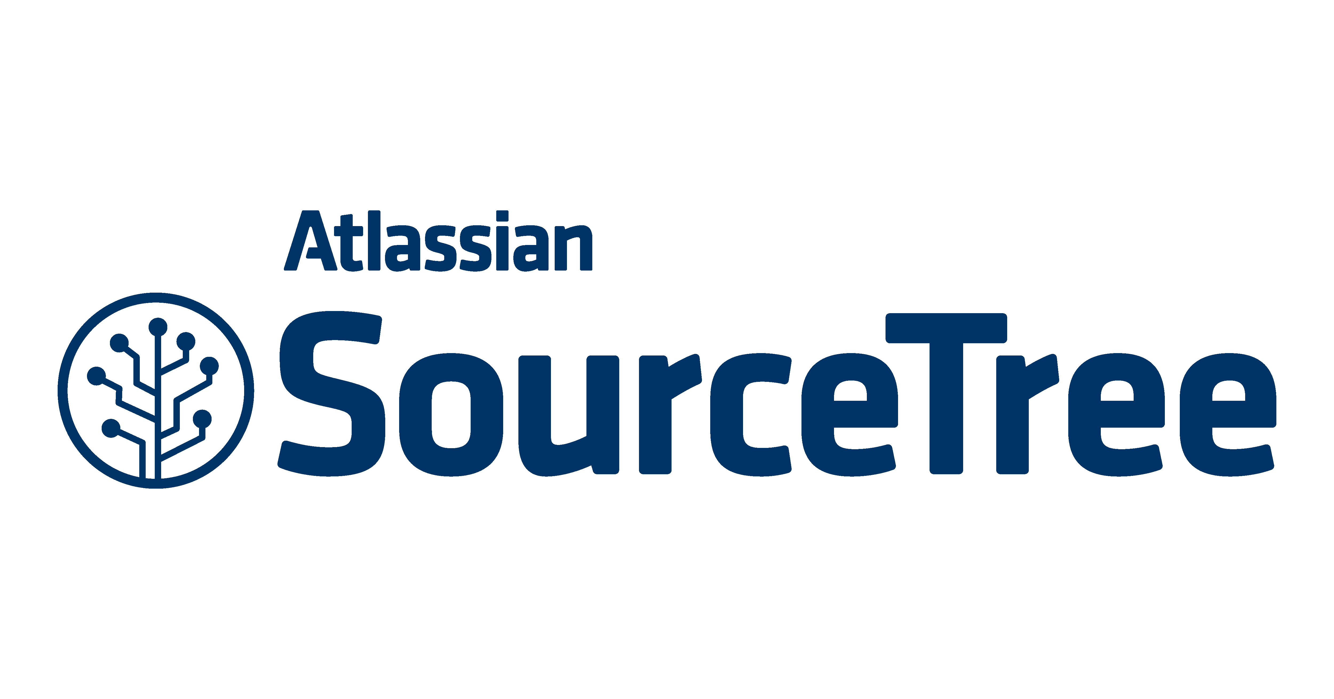

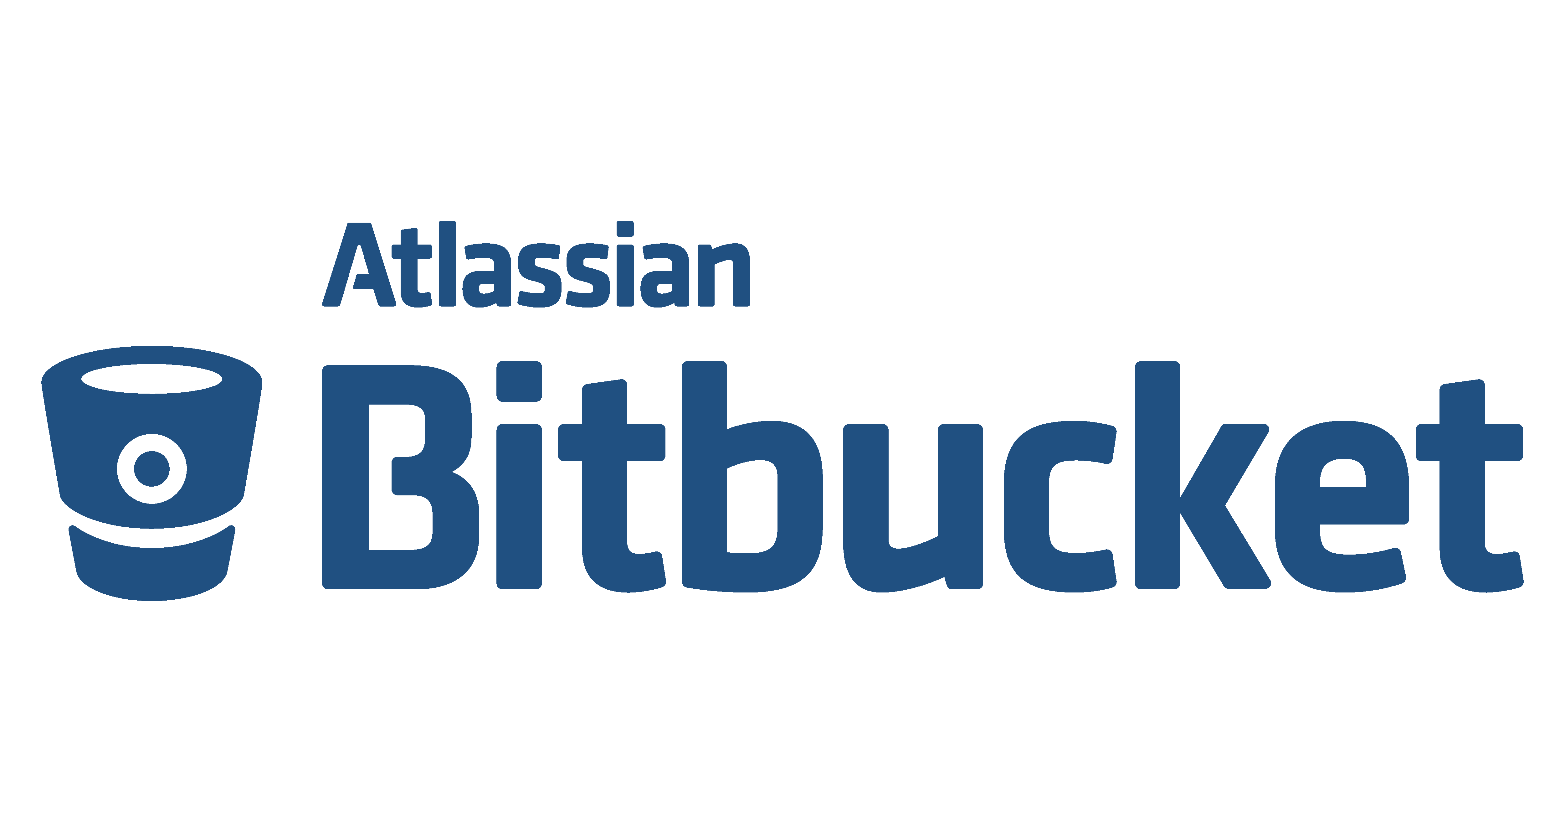













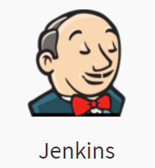

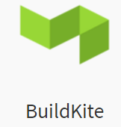

(Distributed) version control system
Web-based repository hosting service
Client
Chat and collaboration tools
Project management
Testing

Slide 14
Contents
What is version control and why do we need it?
What is Git?
Why Git, GitHub and GitLab?
Demo: Vermogensmonitor en CE Package
Frequent Git Actions
Final Note: Why open scource is important

Slide 15
Contents
What is version control and why do we need it?
What is Git?
Why Git, GitHub and GitLab?
Demo: Vermogensmonitor en CE Package
Frequent Git Actions
Final Note: Why open scource is important

Slide 16

Most important Git actions?
Branching
When you create a branch in your project, you're creating an environment where you can try out new ideas. Changes you make on a branch don't affect the master branch
Committing
This process of adding commits keeps track of your progress as you work on a feature branch. Commits also create a transparent history of your work that others can follow to understand what you've done and why. Each commit has an associated commit message
Pull requests
Pull Requests initiate discussion about your commits. Because they're tightly integrated with the underlying Git repository, anyone can see exactly what changes would be merged if they accept your request.
Learning to use the power of Git can take some time, however once learned, that power can be used to increase development speed.

Slide 17
Most important Git actions?
Code review
During code review, the person or team reviewing your changes may have questions or comments. This may lead to adjustments to the branch you want to merge.
Deploying
Once your pull request has been reviewed and the branch passes your tests, you can deploy your changes to verify them in production.
Merging
Now that your changes have been verified in production, it is time to merge your code into the master branch. Once merged, Pull Requests preserve a record of the historical changes to your code. Because they're searchable, they let anyone go back in time to understand why and how a decision was made.
Have a look here for more
Learning to use the power of Git can take some time, however once learned, that power can be used to increase development speed.

Slide 18
Contents
What is version control and why do we need it?
What is Git?
Why Git, GitHub and GitLab?
Demo: Vermogensmonitor en CE Package
Frequent Git Actions
Final Note: Why open scource is important

Slide 19

Why open source is important (for Data Science).

Slide 20

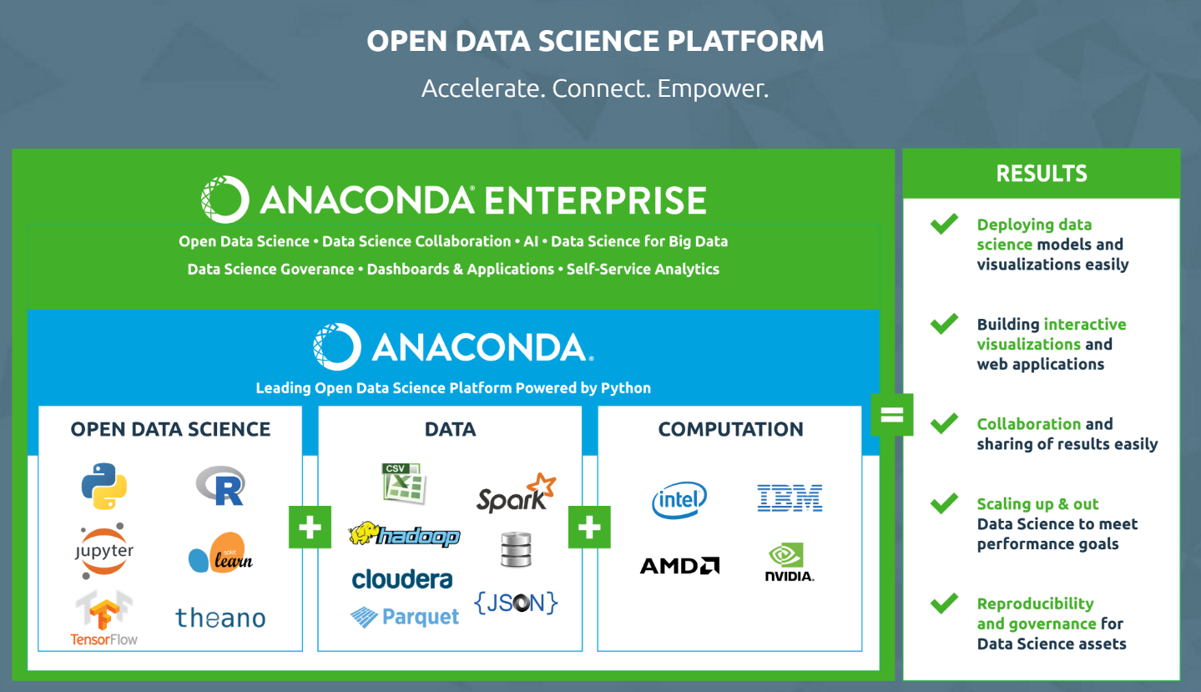

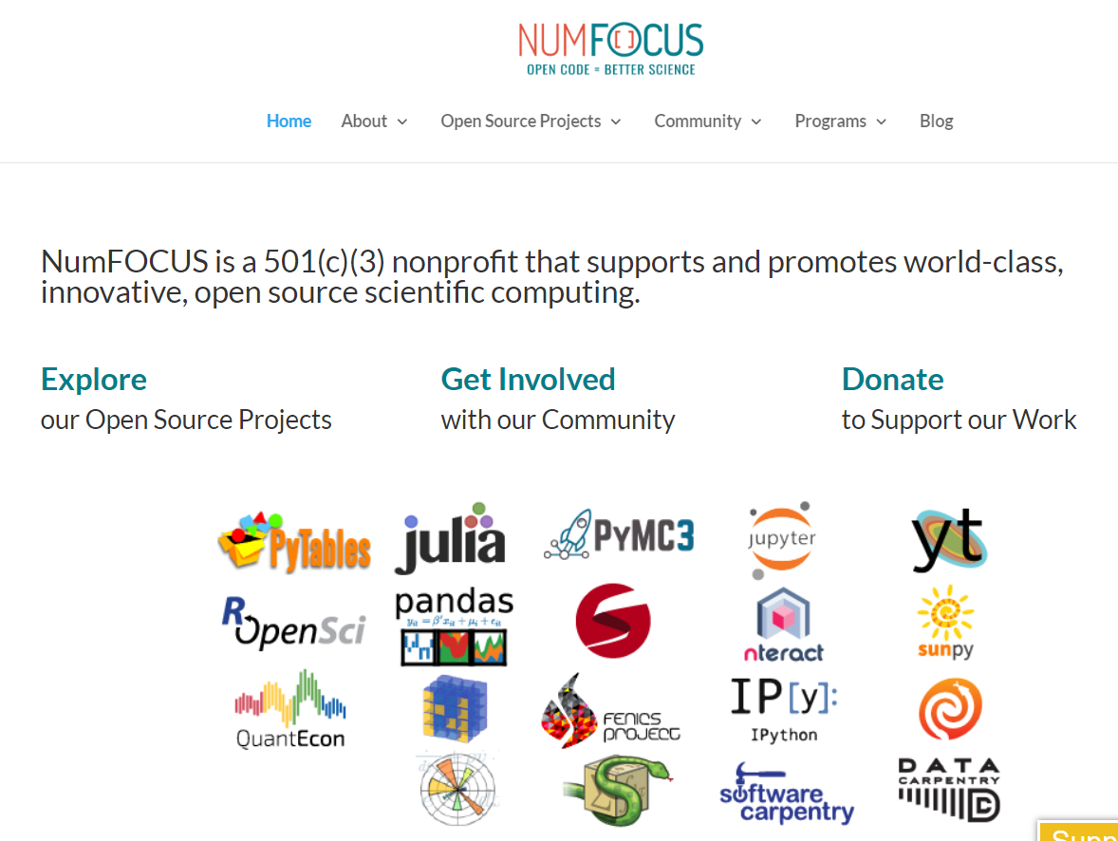
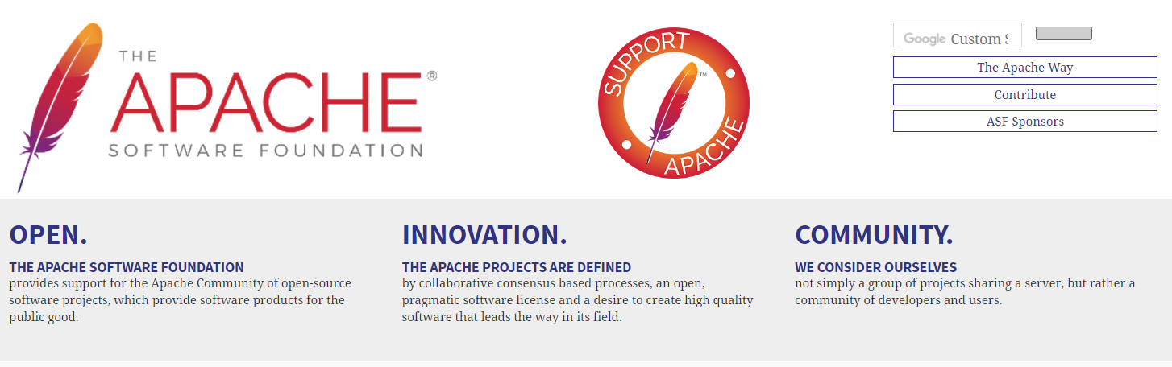
Open Source

Slide 21
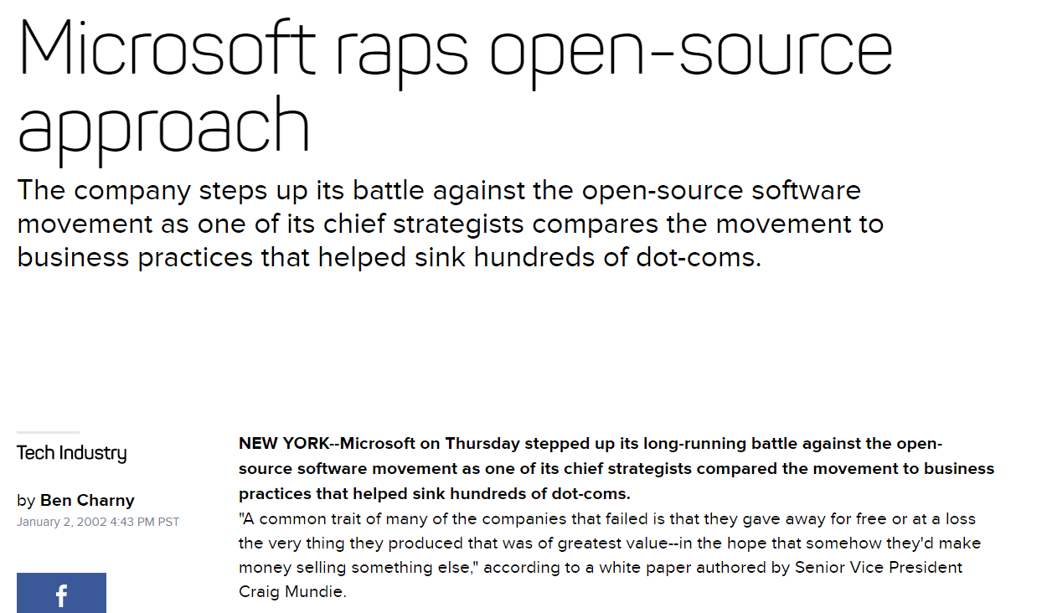

Slide 22

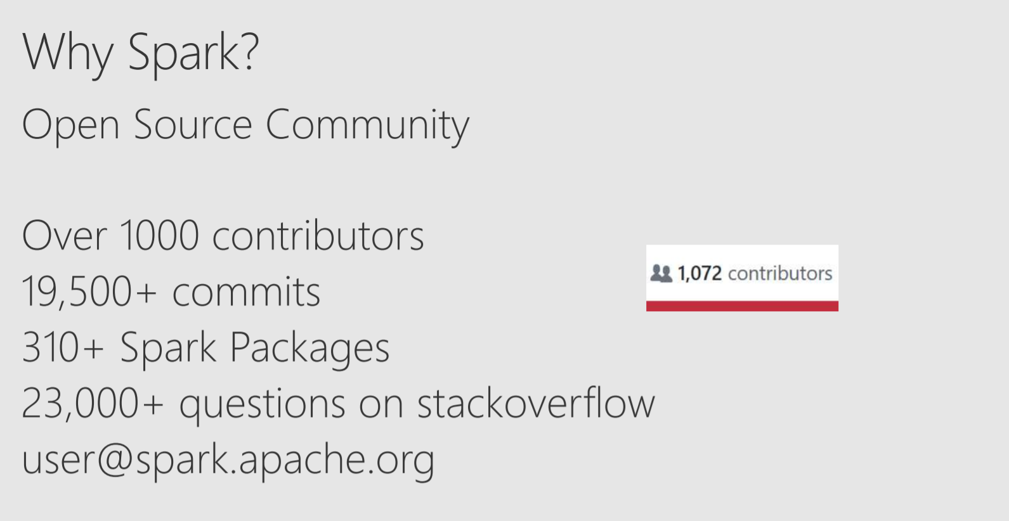


Slide 23
